Slide 1
Studio 3B
Product Assessment 💯
Created with ❤ by TEAM 3

Slide 2
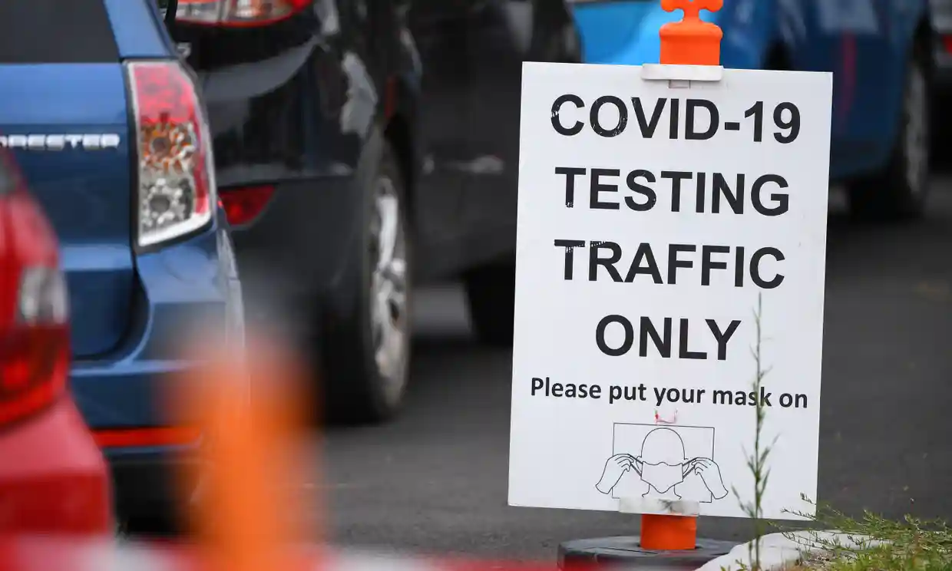
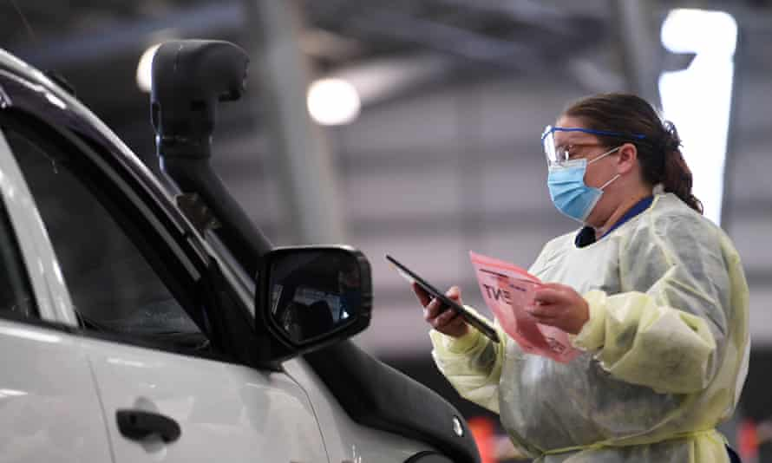
The Problem ❗
                "But locals have hit out at the plans for the (testing) facility saying it heightens the risk of families contracting the virus." (Yahoo News)
                People have a fear of visiting testing clinics as they believe it will spread Covid-19.

Slide 3
Research and Users’ Needs 👨‍🔬
                Patients 🤒
                Patients are today anxious that they have COVID when they suffer from common symptoms like cough, cold, etc. and want to consult a doctor to know for sure. 😰
                If they have a high likelihood of COVID, they also want to know the nearest general practitioners who they can consult. 🩺
                Difficulty in managing all medical appointments through personal calendars. 📆
                Doctors 👨‍⚕️
                Doctors are receiving many patients who think they have COVID, but they are suffering from other diseases. This leads to wasted time and resources on the healthcare system. ⏳
                Managing appointments from COVID test related patients on their systems is an additional overload and can be outsourced. 📆

Slide 4
Comparisons or Differences 🕶
Us 👍 | Existing Services 👎
Integrated chatbot for early diagnosis | Must have consultation with a real doctor
Initial diagnosis, appointment management in an all-in-one centralised platform | No centralised platform
Visual representation of ailments on 3D model | No 3D model to visualise diagnosis
Available as a cross-platform web-app | Tied to specific platform, such as iOS, Android or only desktops

Slide 5
Project Scope 🔭
                We are building an interactive software solution to help you understand –
                How likely you are to have COVID-19 based on your symptoms 😷
                Visualize your condition in real-time 💹
                Supporting you with your next steps 📌
                And helping you get in touch with a medical professional as soon as possible, if required 👩‍⚕️
                All by leveraging the power of artificial intelligence. 🤖

Slide 6





Leveraged Technologies 💻
Technical Stack 🥞
The frontend was built on React utilising Firebase for the backend and database.
Key Technical Features 💻
Machine Learning Chatbot - A way to provide a customer interaction with health statistics and recommendations
3D Modelling - Provides the user with an educational and interactive 3D visualization of their health condition, built using the three.js library.
COVID-19 Prediction Model – Leverages LightGBM (gradient boosted decision trees), hosted on Amazon EC2

Slide 7
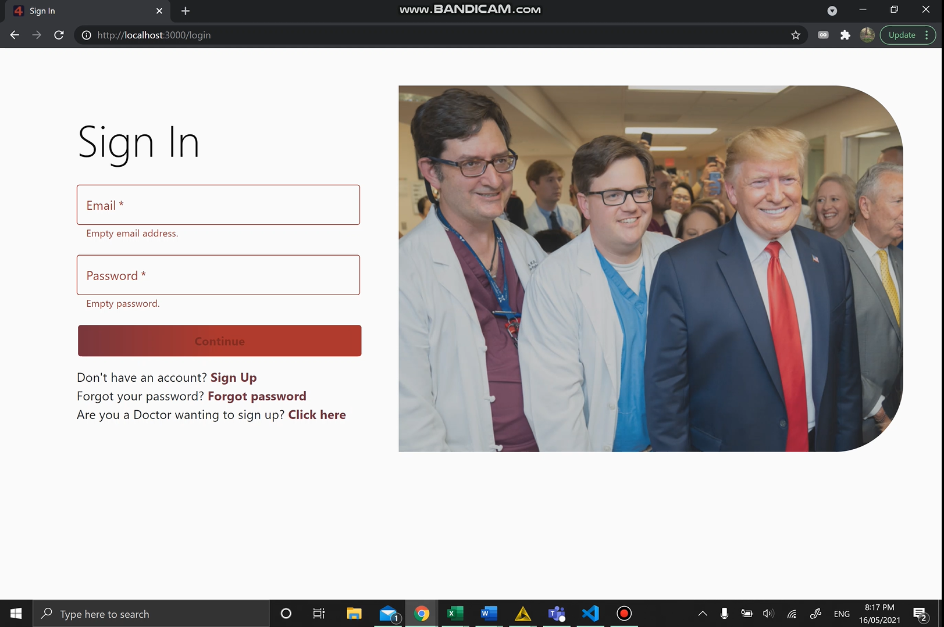
Software Overview 🗺
Quick 2 Min Overview:
https://www.youtube.com/watch?v=09UxepRxEh8
Detailed demo:
https://www.youtube.com/watch?v=kTq2JjHzO0A

Slide 8
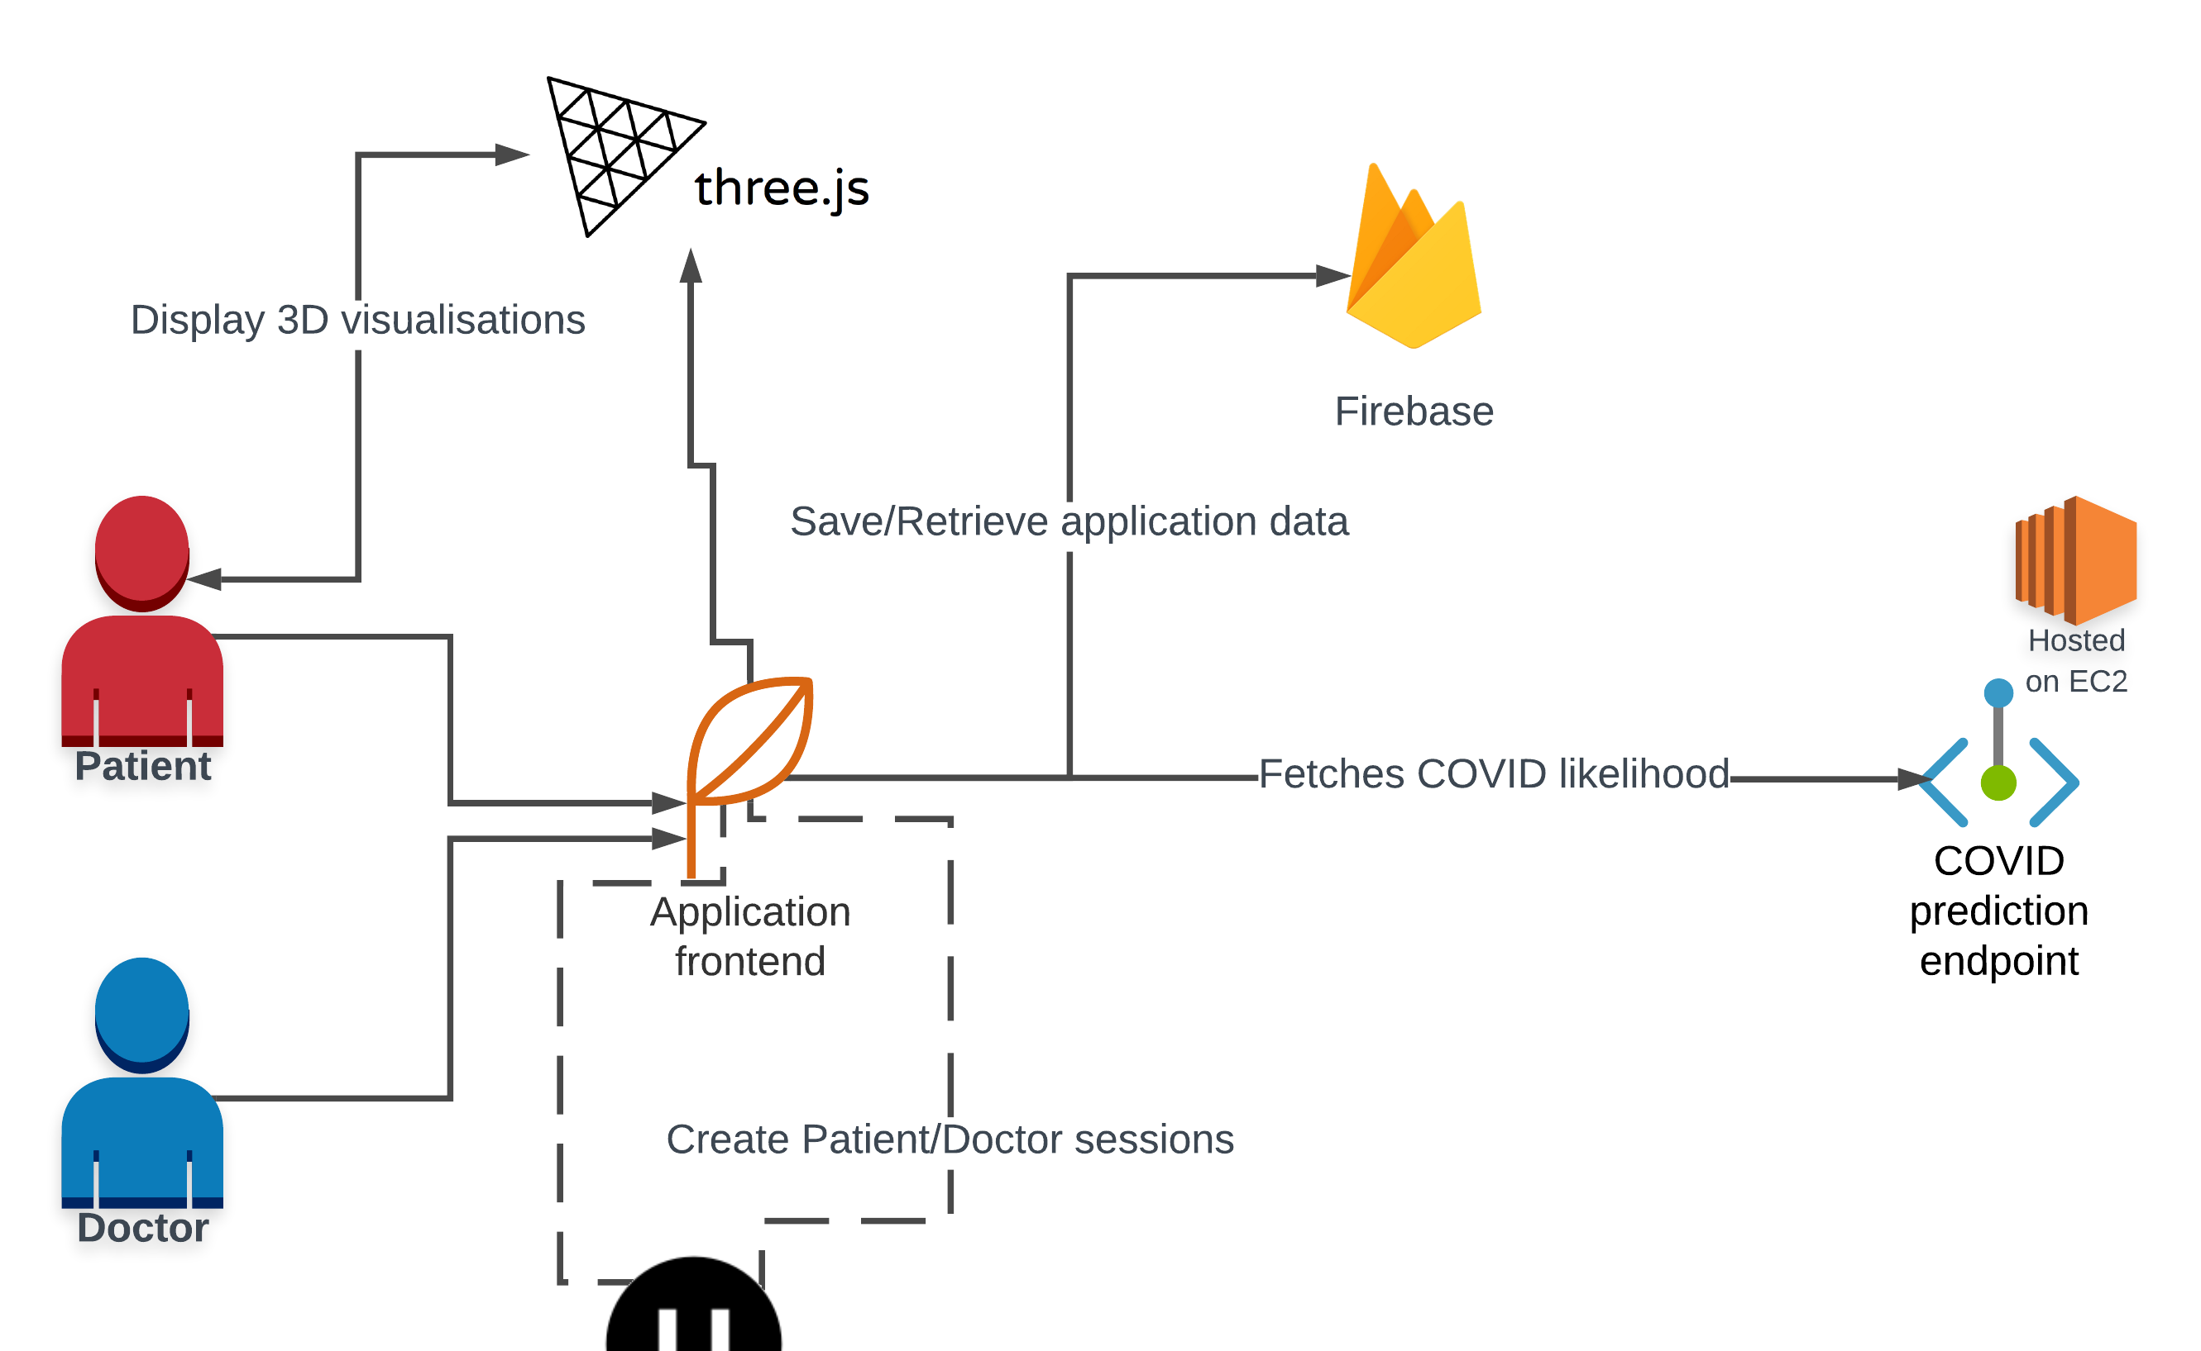
Software Architecture
👷‍♂️

Slide 9
Top features 🤩
Predict your COVID-19 likelihood, just by giving us your symptoms using the power of AI! 🩺
Decide whether you need to see a doctor based on your COVID-likelihood 🤔
Find nearby COVID testing clinics and book in an appointment with them with a couple of clicks 🏥
Visualize your COVID situation in an interactive and exciting 3D view! 📈
Live chat with a medical professional if you’re in a hurry 👨‍⚕️

Slide 10
Next Steps 💡
Profits and Investments 🤑
Advertising
Commissions based on partnerships with medical practitioners
Government grants
Future Markets 🌏
Expanding into the wider health community where it can be used in hospitals by doctors and nurses
Expanding to foreign markets, with higher COVID cases, ex - India
Converting our website into packaged software suitable in the medical field where hospitals may be able to use them

Slide 11
Next Steps 💡
Research input 🔬
Obtaining research from the medical field and implementing it into our application
Implementing more sophisticated and reliable algorithms within our application
Gaining approval from the medical field of the correctness and suitability of our application
More features! 🌈
A more refined and reliable machine learning chatbot
A more generalised location feature which covers other contagious diseases such as influenza

Slide 12
Teamwork review 😎
Good Things 🙂
Strong and honest communication
Remote collaboration
Effective task delegation
Meetings and meeting minutes were consistent and informative.
Not so Good 😐
Knowledge gaps Group members need to ask more questions if they get stuck.
Task tracking on Trello could improve project management
Bad Things ☹
Time Management and overall progress Planning and trying to delegate more time towards implementing features could help.

Slide 13
Project Timeline Review ⏳
Achievements 🌟
🎯 March - Planning
Ideation, project structure, project environment, organisational foundations
🎯 April – Building
Backend deployment, dashboard, appointments, chatbot
🎯 May – Finishing Touches and Integration
Locations, 3D models, live chat, function integration, news, styling finalisation
Our Difference ⚡
Our projects differentiates itself from the competition thanks to its intuitive and user-friendly interface and design-thinking ideology.
We have developed our laser focused on user needs application in our current global landscape.
Moving Forward ▶
We would remove hazards in user safety by collaborating with the NSW government to ensure that medical and safety regulations are followed in accordance with statewide procedures. Increased security on the backend will help us partner with government organisations.

Slide 14

Thank YOU! ANY Questions ❔

